Slide 1

Text-Based motion detection
Datasets & current advances

Slide 2
Text Based Emotion Detection
Team Members
Malak Emad
Shady Zekry
Kirollos Hany
Kirollos George
Fady Fayek
Seif Altahawy

Slide 3
Introduction
Our idea is to have a chat application with an additional feature that is to detect the emotion based on the text this will help with the miscommunication that happens often in chatting applications due to the nature of it.

Slide 4
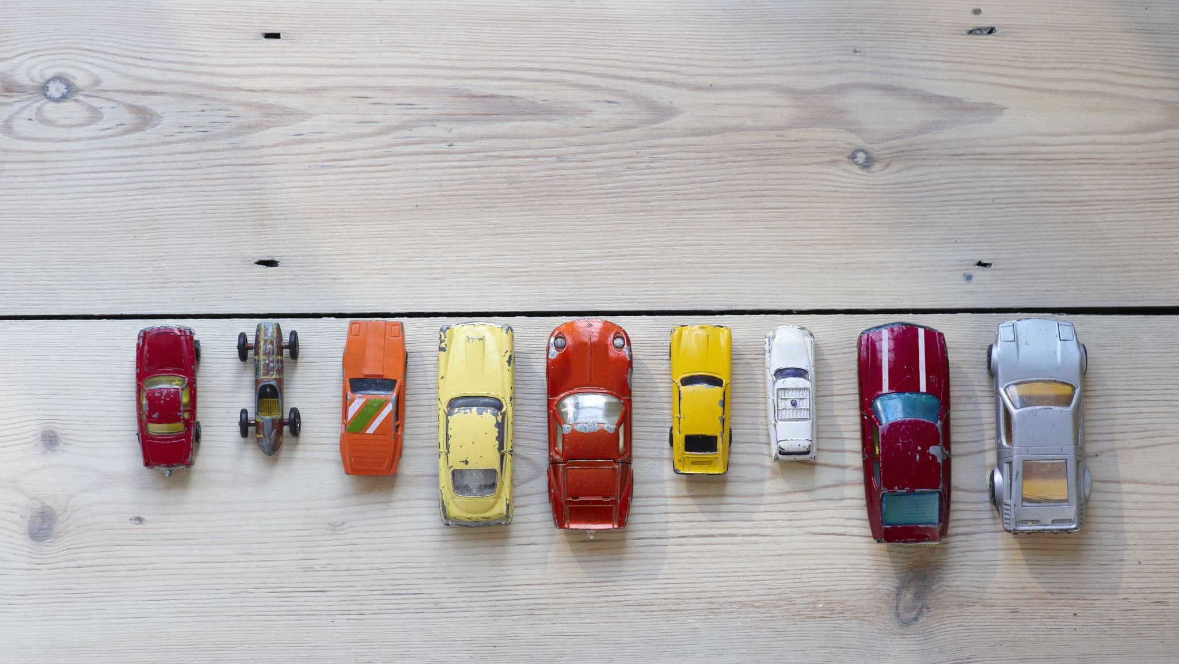
Main Models

Slide 5
Types of ED models
1-Discrete Emotion Models (DEMs)
2-Dimensional Emotion Models (DIEMs)

Slide 6
Discrete Emotion Models
The discrete model of emotions involves placing emotions into distinct independent classes
Discrete Emotion Models:
The Paul Ekman Model
6 basic emotions: happiness, sadness, anger, disgust, fear and surprise
The Robert Plutchik Model
Added 2 emotions (acceptance and trust) on the 6 proposed by Ekman and created new emotions using combinations of these emotions
OCC Model
Added 16 more emotions to the emotions proposed by Plutchik and Ekman and each emotion has a degree of intensity

Slide 7
Dimensional Emotions Models
The dimensional model presupposes that emotions are not independent and that there exists a relation between them hence the need to place them in a spatial space
Dimensional Emotions Models:
Russel and Mehrabian Model:
Three-dimensional model where third dimension represents the degree of control individuals had over their emotions
Russel Model:
Two-dimensional circle called circumplex of affect

Slide 8
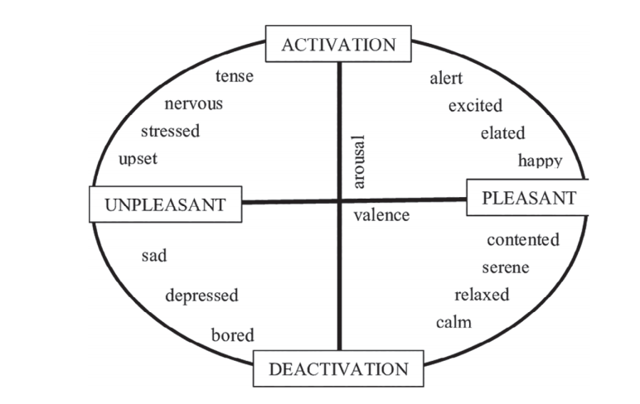
Russel Dimensional Emotion Model

Slide 9
Techniques And Algorithms
LSTM to CNN (65.97% Accuracy)
SVM and NB (59.2% Accuracy)

Slide 10

Publicly available datasets for detecting emotions in texts

Slide 11
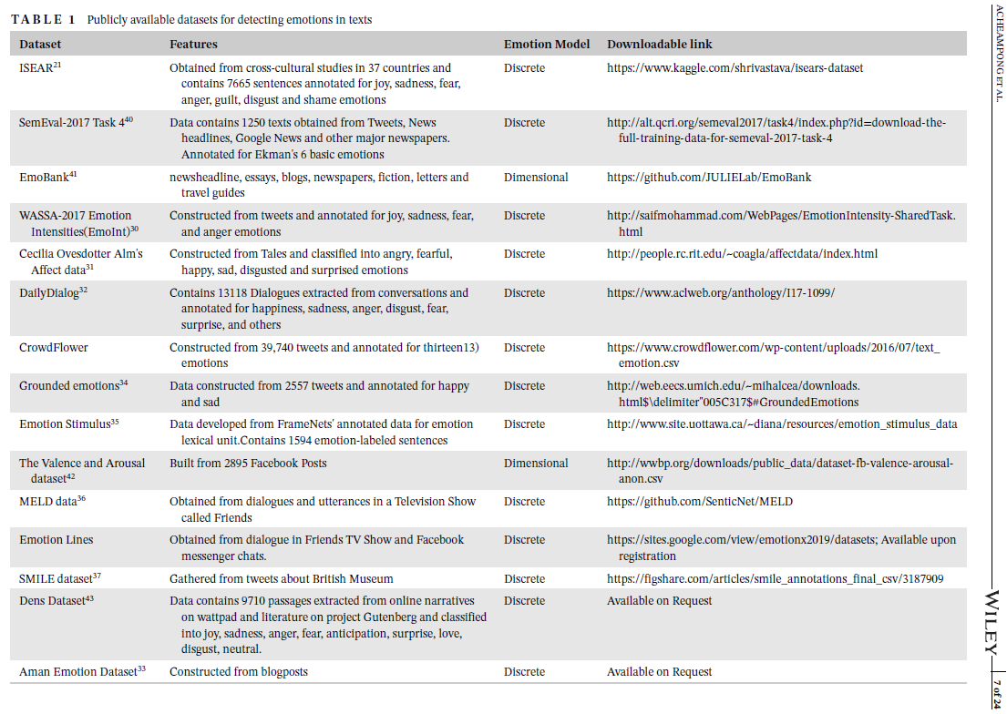

Slide 12

Summary of current advances in text-based emotion detection

Slide 13
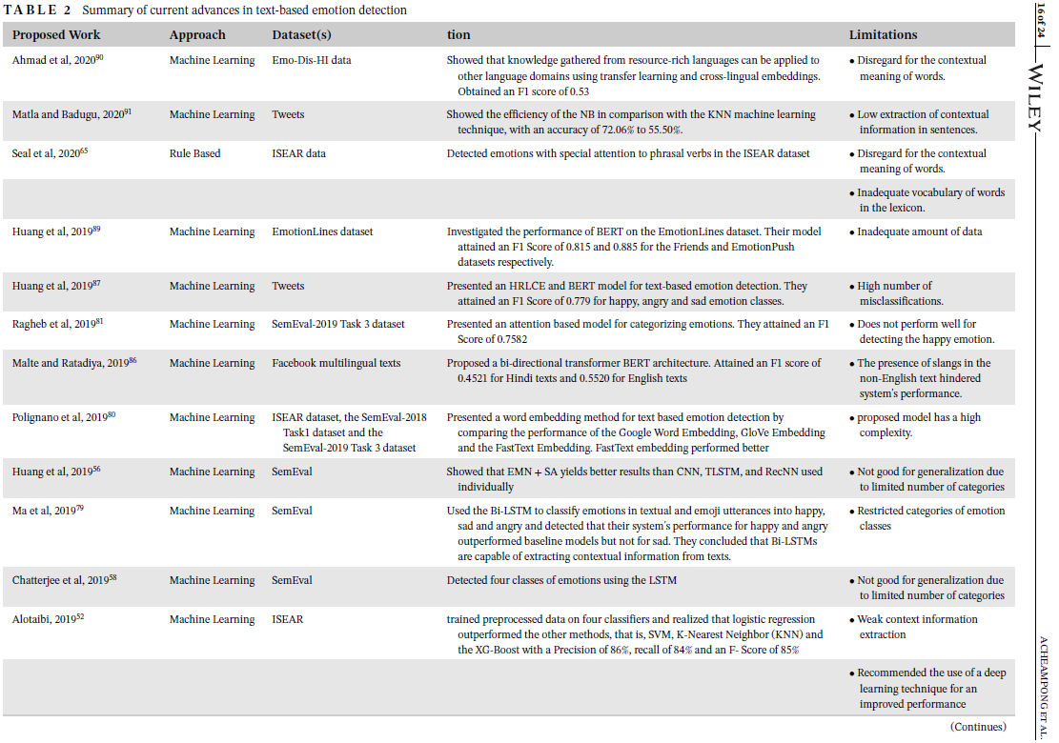

Slide 14
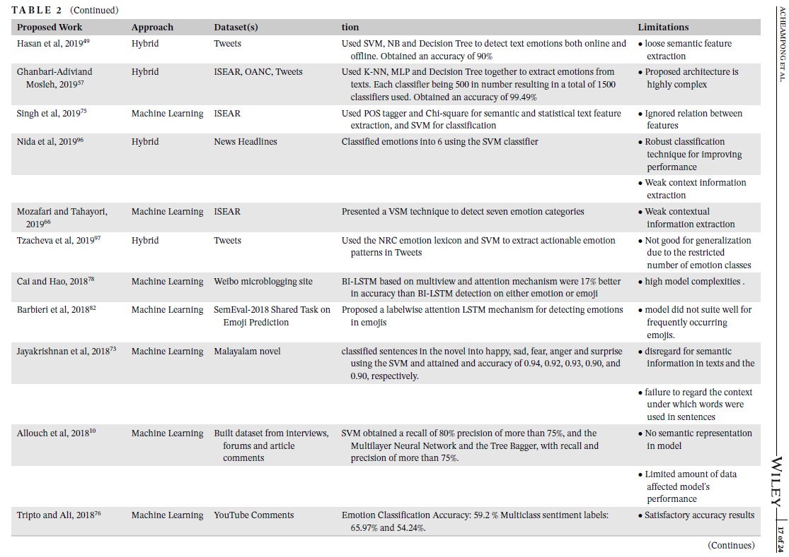

Slide 15
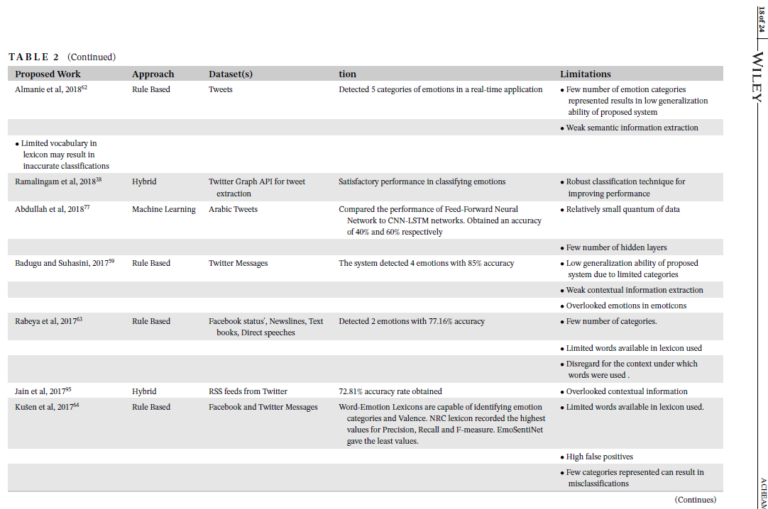

Slide 16
